Slide 1
PRADHAN MANTHRI KRISHI SINJAYEE YOJANA-WATERSHEDDEVELOPMENT COMPONENT (PMKSY-WDC)

Slide 2
Objectives
To restore the ecological balance, by harnessing, conserving and developing our degraded natural resources such as soil, water and vegetative cover.
The outcomes envisaged in the programme are
prevention of soil erosion
regeneration of natural vegetation
rain water harvesting
recharging of ground water.
This enables multi cropping and the introduction of diverse agro-based activities, which help to provide sustainable livelihoods to the people residing in the watershed area.

Slide 3
It is an area development programme.
The major goal is to conserve as much rain water as possible both as surface water and subsurface water thereby catering the needs of water both for domestic and agriculture during summer.
Drought proofing is the main agenda behind this. Activities related with the above are undertaken which includes soil and moisture conservation activities, Water Harvesting Structure construction and renovation, installation of ground water recharge structure including well recharge, Renovation of traditional water harvesting structure, cleaning of drainage channels for safe disposal of flood water, as well as reclamation of water inundated areas, reclamation of cultivable waste lands etc.

Slide 4
Initially the name of the scheme was IWMP with Central : State Share of ration 90:10. During 2015-16, IWMP was amalgamated under PMKSY as its Watershed Development Component and the Central : State Share ratio shifted to 60:40.

Slide 5
Financial Status for the current Year 2018-19
The tentative budget allocation of Central Share is Rs. 21.77 Cr.
1st installment of Central Share released Rs. 13.06 Cr.
State Government also released corresponding State Share Rs. 8.71 Cr.
Total funds received is Rs. 21.77 Cr.

Slide 6
1. Achievements of the Programmes implemented in Kerala
Physical Achievement under PMKSY-WDC
Item | 2014-15 | 2015-16 | 2016-17 | 2017-18 | 2018-19
 | No. | No. | No. | No. | No
Check dam constructed | 127 | 61 | 50 | 33 | 1
Percolation tank | 0 | 3 | 44 | 0 | 0
Farm pond | 46 | 49 | 34 | 246 | 23
Other Water Harvesting Structures | 4793 | 1540 | 1981 | 4443 | 488
Old Water Harvesting Structures rennovated | 276 | 952 | 578 | 101 | 48
Additional Area brought under irrigation | 598(ha) | 6897(ha) | 5544(ha) | 7694(ha) | 454.42 (ha)
No. of farmers benefited | 34622 | 20710 | 27987 | 19006 | 8682
Mandays Generated | 51273 | 82370 | 76072 | 59717 | 164860
Plantation including Horticulture | 642 Ha. | 880 Ha. | 4397 Ha. | 1568 Ha. | 73.07 Ha.
Livelihood support provided | 320 JLG | 603 JLG | 2999 JLGs | 80 JLG | 0
Soil & Moisture Conservation activities undertaken | 2050.Ha | 2149.Ha | 4029.Ha | 4295.Ha | 1208.17Ha
Drainage line treatment activities undertakes | 492(cum) | 1203 (cum) | 32391 (cum) | 6431 (cum) | 102749 (cum)
Production enhancement activities undertaken | 185 Ha | 466 Ha | 952 Ha | 456 Ha | 155 Ha

Slide 7
Financial Achievement under PMKSY-WDC
Sl. No. | Financial Year | Total Release |  |  | Mis. Receipt & Interest | Grand Total | Expenditure
 |  | Central Release | State Release | Total
1 | 2009-10 | 0 | 0 | 0 | 0 | 0 | 0
2 | 2010-11 | 422.31 | 46.923 | 469.23 | 8.398 | 477.63 | 0
3 | 2011-12 | 1664.51 | 184.945 | 1849.46 | 47.647 | 1897.102 | 160.889
4 | 2012-13 | 577.05 | 57.704 | 634.75 | 89.154 | 723.906 | 363.06
5 | 2013-14 | 0.00 | 6.41 | 6.41 | 147.768 | 154.178 | 1178.3
6 | 2014-15 | 1516.00 | 168.44 | 1684.44 | 161.446 | 1845.886 | 3257.098
7 | 2015-16 | 2000.00 | 1333.00 | 3333.00 | 129.601 | 3462.601 | 2915.32
8 | 2016-17 | 1662.00 | 1108.00 | 2770.00 | 137.94 | 2907.94 | 2609.84
9 | 2017-18 | 1783.00 | 1188.57 | 2971.57 | 5.313 | 2976.883 | 2241.13
10 | 2018-19 | 1306.00 | 871 | 2177.00 | 0.096 | 2177.096 | 568.45
Total |  | 10930.87 | 4964.99 | 15895.86 | 727.36 | 16623.22 | 13368.00

Slide 8
2. Whether all the objectives set for the above programmes were met with satisfaction of the DoLR? If not, what have been the shortcomings?
No,
Eventhough 83 projects were sanctioned to Kerala at a total outlay of Rs.581.61 Cr, this amount is not available for implementation. Due to the shortage of funds, DoLR had issued directions for the qualitative and timely completion of PMKSY-WDC Projects with available resources and through convergence with other Central and State schemes of line departments.
The major centrally sponsored scheme for convergence is MGNREGS. Even though earnest effort were initiated for convergence at grass root level, the convergence is not much effective.
Proper synchronisation does not occur between convergence activities and PMKSY-WDC activities at field level which in turn affects the quality of work executed.

Slide 9
3. What are the priorities of State of Kerala in the current fiscal year i.e. 2018-19?
In the current fiscal year the main priority is for the completion of Batch-3 projects (15 Nos) as well as repair and renovation of assets damaged during the recent floods, created under PMKSY during earlier periods

Slide 10
4. How many IWMP projects are there in the State of Kerala? Provide Batch-wise details along with the sanctioned year of those projects. By when these Projects are likely to be completed?
S. No. | Batch | Project Sanctioned Year | No of Projects | Area Sanctioned (Ha) | Total Cost (Rs in Crores) | Year of Completion | Remarks
1 | II | 2010-11 | 26 | 141859 | 203.97 | 2017-18 | Completed
2 | III | 2011-12 | 15 | 82315 | 106.86 | 2018-19 | Ongoing
3 | IV | 2012-13 | 20 | 96396 | 129.27 | 2019-20
5 | V | 2013-14 | 12 | 51083 | 69.26 | 2020-21
6 | VI | 2014-15 | 10 | 51333 | 72.27 | 2021-22
Total |  |  | 83 | 422987 | 581.62

Slide 11
5. Whether any third party evaluation has been done in the State of Kerala of the IWMP? If so, what steps have been initiated with regard to the findings of the third party evaluation report?
Yes,
We have already entrusted Centre for Water Resources Development and Management (CWRDM) as the third party evaluator for conducting the end line evaluation of PMKSY-WDC Projects in Kerala. SLNA had executed MoU with CWRDM on 25.10.2018. The evaluation process is going on.

Slide 12
6. Information/suggestion/experience you may like to share with the Committee
In Kerala 14 projects falling under Batch-IV, V & VI are transferred to State’s Budget. Since Kerala is facing a critical situation due to recent floods, the chances of getting funds for the implementation of the 14 Projects from the State’s budget is in doubt. Hence all the 14 projects which are already in the work phase of implementation may also be allowed to continue utilising both Central and State share

Slide 13
SOME INITIATIVES UNDER PMKSY (ERSTWHILE IWMP)

Slide 14
Kannur-IWMP-6/2014-15, Thaliparamb Block, Stream Bank Protection

Slide 15
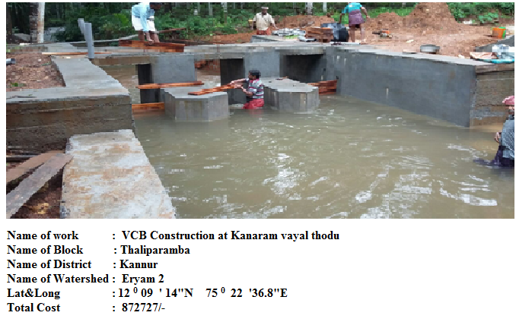
Kannur-IWMP-6/2014-15 VCB Construction-Thaliparamba Block

Slide 16
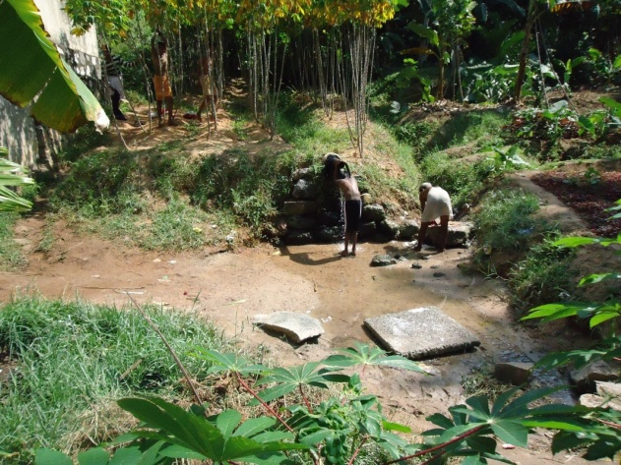
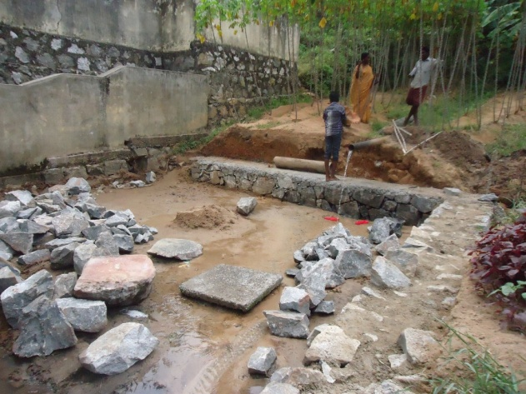
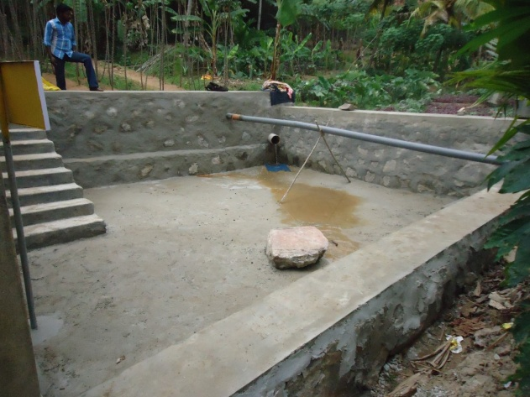
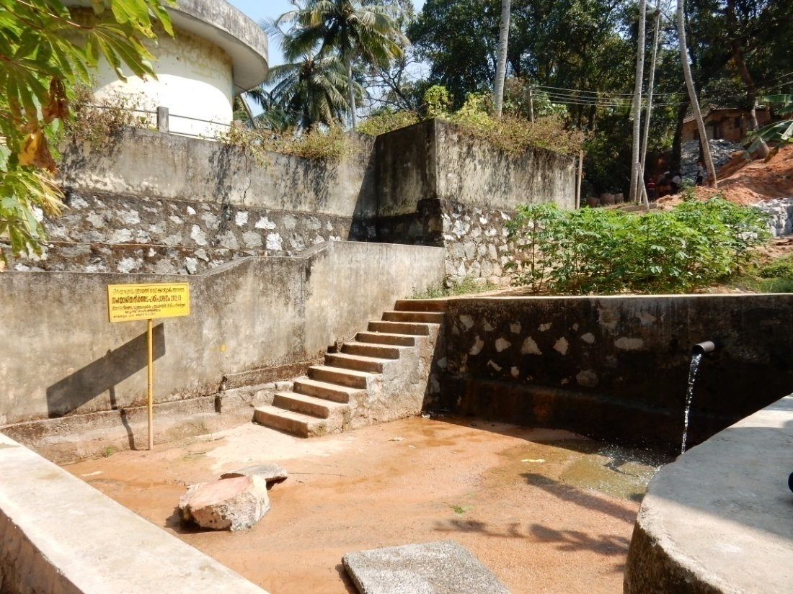
Spring Protection work Chirakkara GP. Ithikkara , Kollam district
The work is the construction of retaining wall around a natural spring through a pipe so that the water can be used for domestic as well as irrigation purposes. Drainage is also provided for the outflow of excess water.

Slide 17
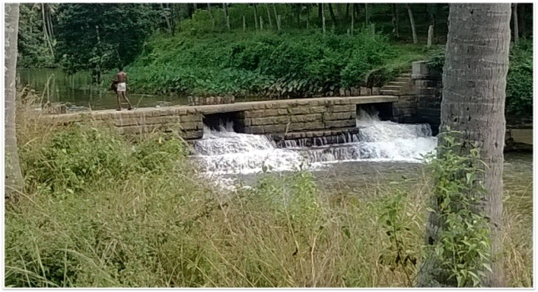
Trivandrum-IWMP-2/2011-12 Chirayinkeezh Block:- Renovation of Pirappankad ela checkdam for paddy and vegetable cultivation.
Iwmp amount
T.S Amount = Rs.350000/-
Bill Amount = Rs.182445/-
Convergance
MGNREGS = 150 mandays-
Agricultural department = Rs.20480/-
After
Before

Slide 18
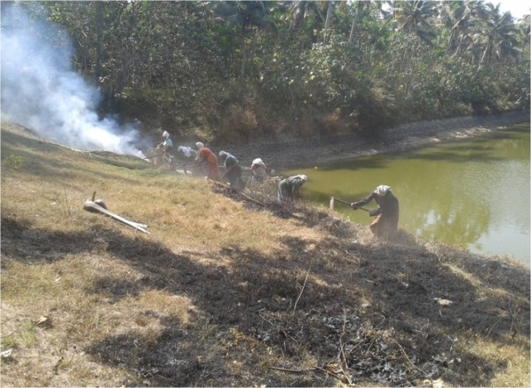
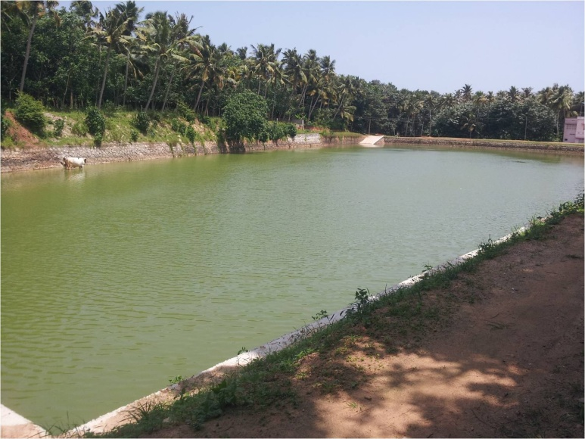
Trivandrum-IWMP-2/2011-12 Chirayinkeezh Block:- Renovation of Parayathukonam chira for paddy and vegetables cultivation.
Iwmp amount
T.S Amount = Rs.310000/-
Bill Amount = Rs.209321/-
Convergance
MGNREGS = 200 mandays
Agricultural department = Rs.15000/-
Fisheries department = Rs.20000/-
Before
After

Slide 19
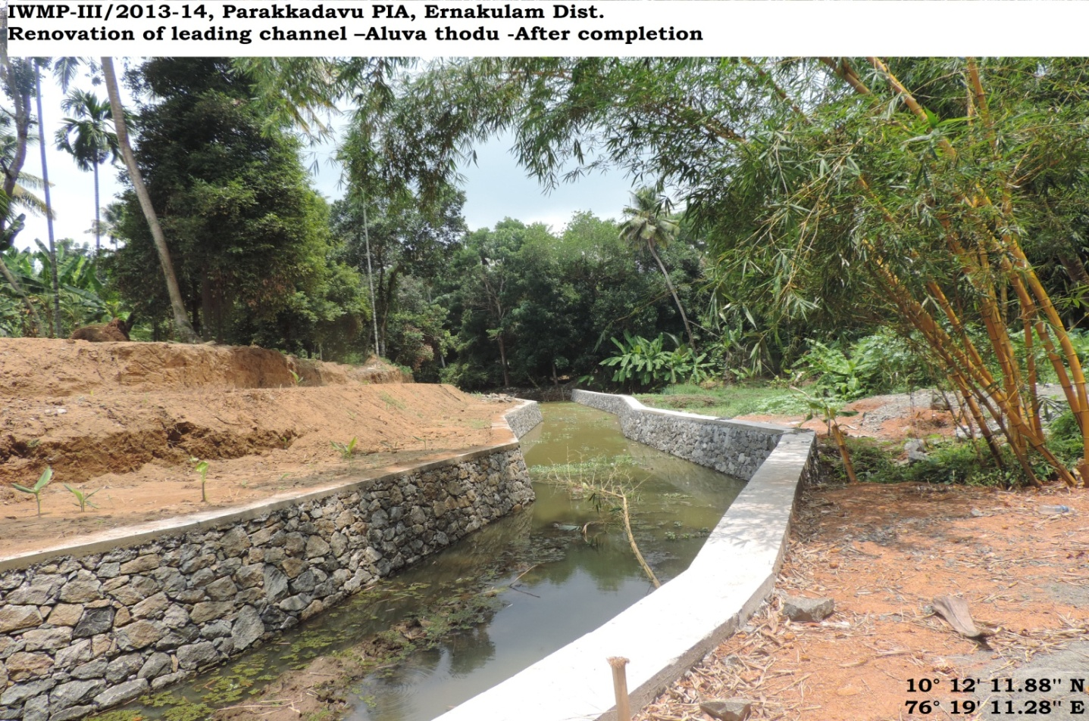
Ernakulam-IWMP-3/2013-14 Parakkadavu Block:- Renovation of leading Channel – Aluva thodu
Before
After

Slide 20
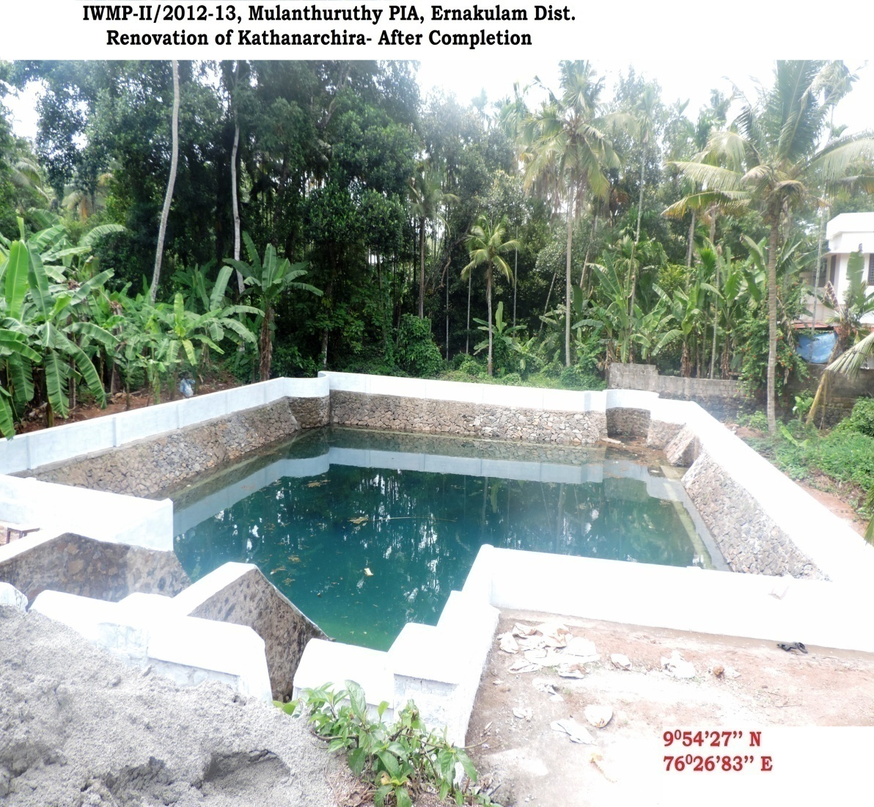
Ernakulam-IWMP-2/2011-12 Mulanthuruthy Block: Renovation of Kanthanrchira
Before
After

Slide 21
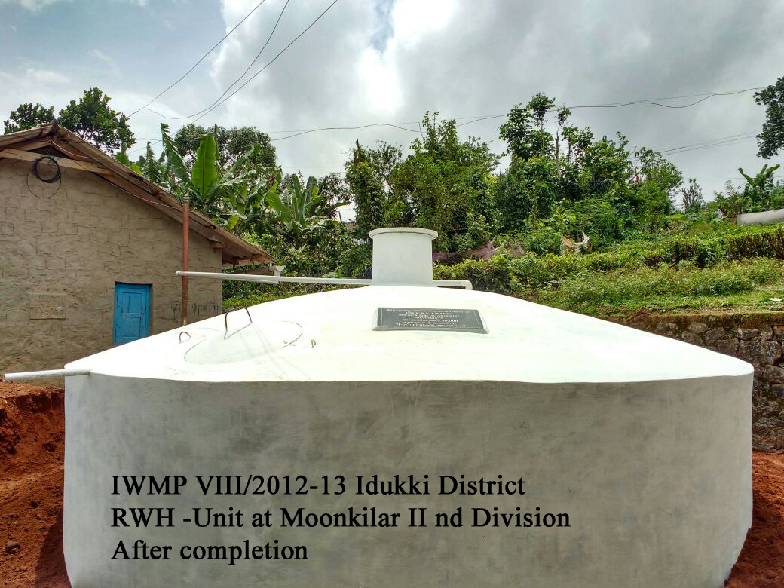
PMKSY-WDC in Idukki District

Slide 22
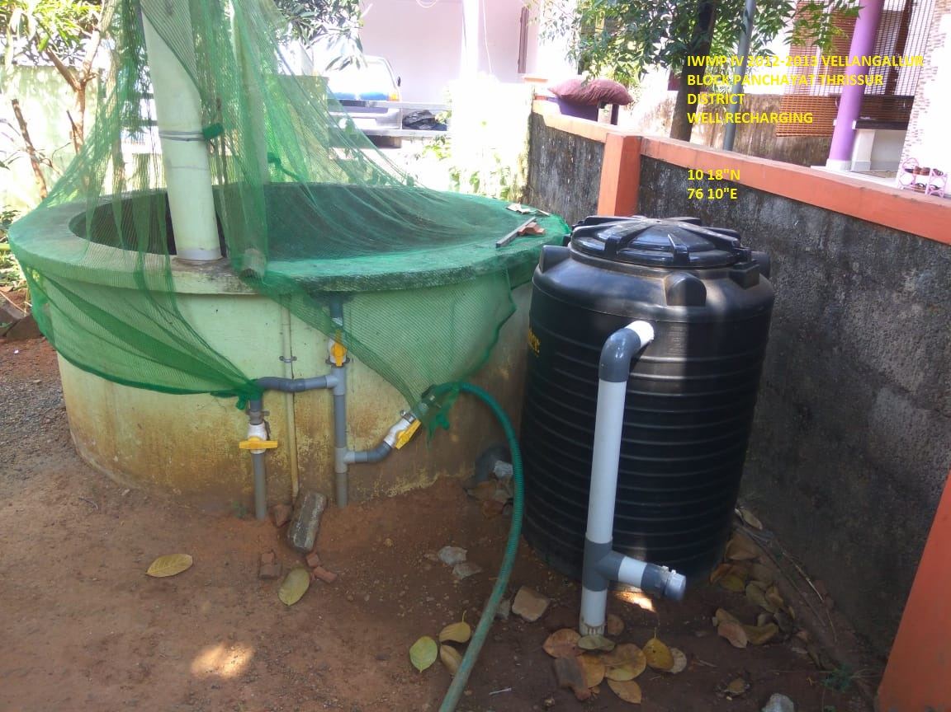
Well Recharge in Thrissur District, Vellangallur Block

Slide 23
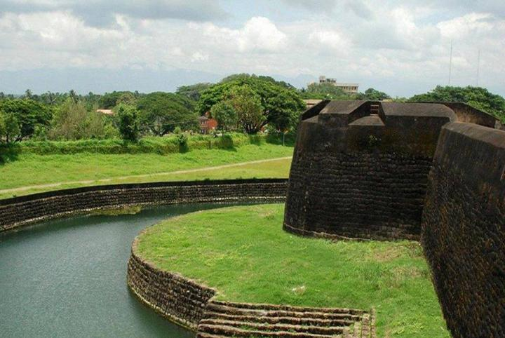
Thank You

